Slide 1

Online Art Gallery Management System
Connecting Artists with Art Buyers Digitally

Slide 2



Project Overview
For Artists
For Buyers
For Admins
Register, upload, set prices, track sales.
Browse, purchase, manage orders.
Manage artists, approve artworks, monitor activities.
Built with ASP.NET Web Forms and SQL Server, ensuring secure and smooth transactions.

Slide 3

The Problem We Solve
Limited Artist Platforms
Artists lack proper platforms to showcase and sell work.
High Commissions & Fees
Traditional and existing online galleries charge excessive fees.
Discovery Challenges
Buyers struggle to find diverse art and connect with artists.
Lack of Verification
Existing platforms often lack artist verification and portfolio management.

Slide 4

Our Solution: Proposed System
Our system offers a comprehensive solution, combining artist portfolio management with robust e-commerce functionality.
Admin verification ensures authentic artists.
Integrated shopping cart for smooth purchases.
Detailed sales reports for artists.
Role-based access control for security.
Low operational costs, benefiting artists.

Slide 5
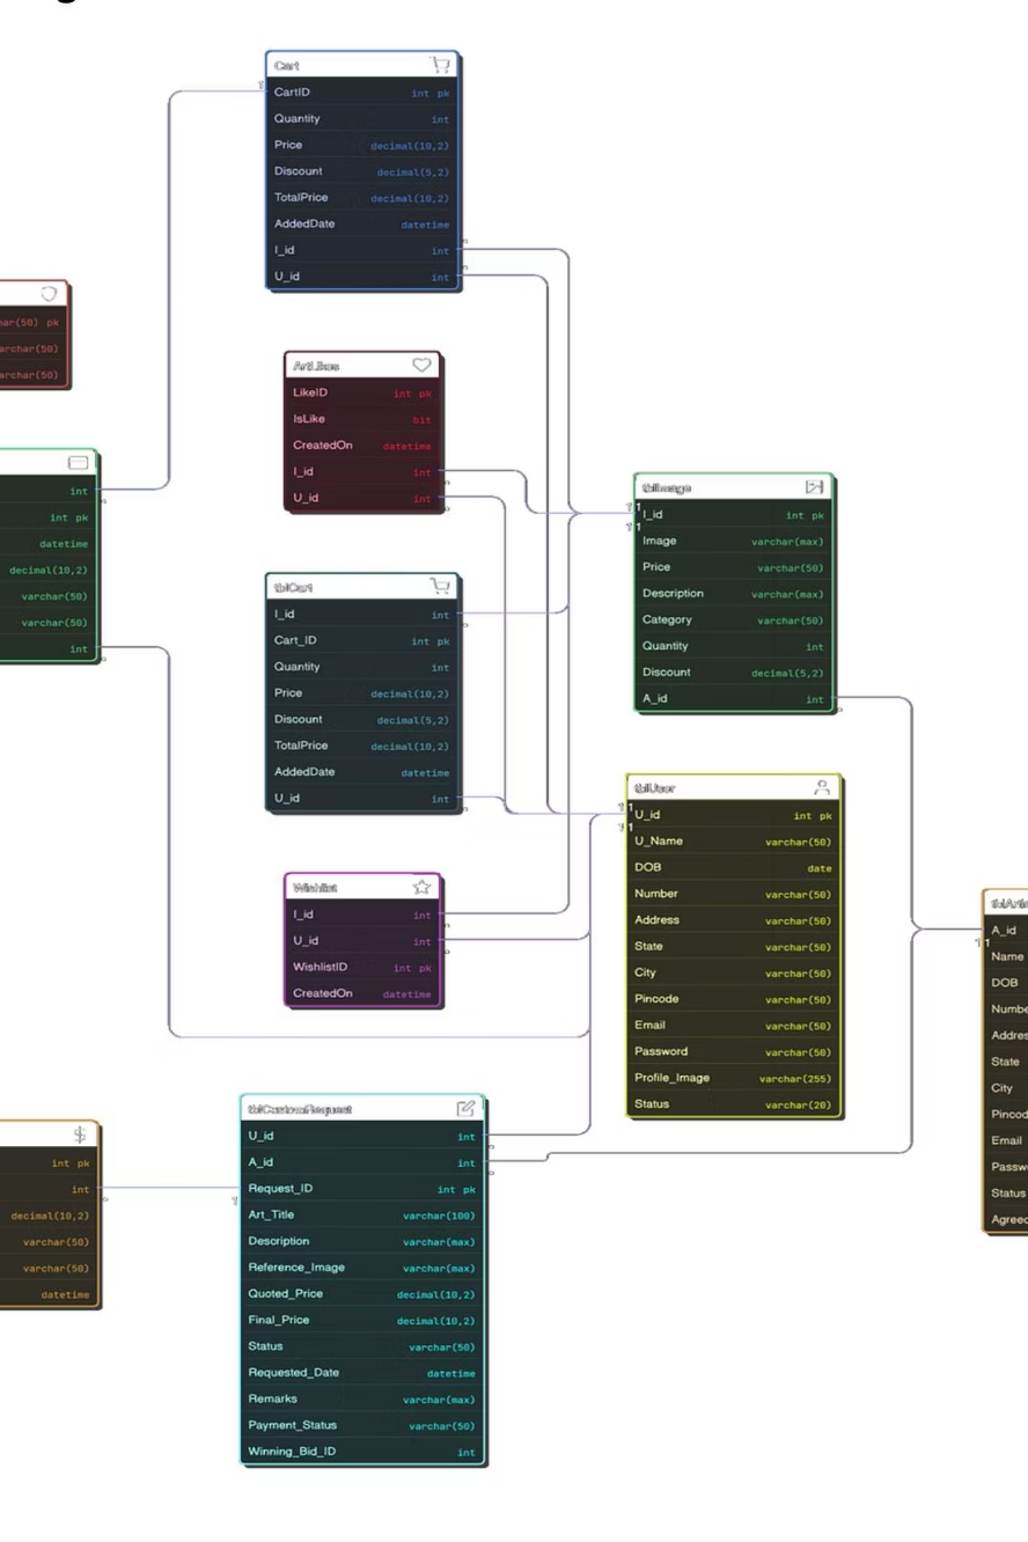
System Architecture: ER Diagram
The Entity-Relationship Diagram illustrates the core entities and their relationships within the system, ensuring data integrity and efficient management of artists, artworks, users, and transactions.

Slide 6
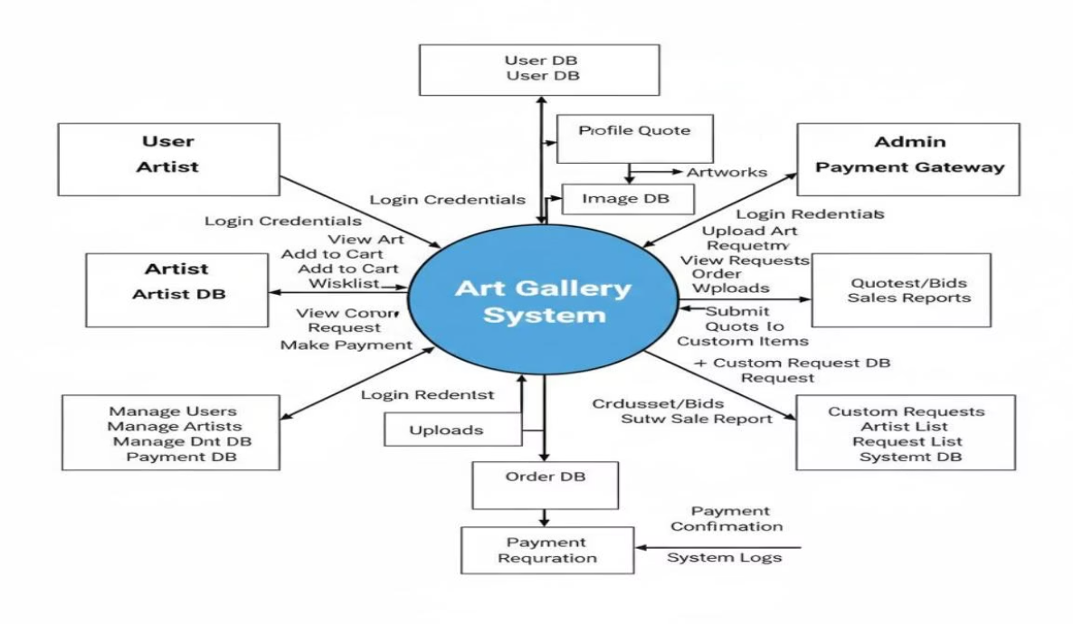
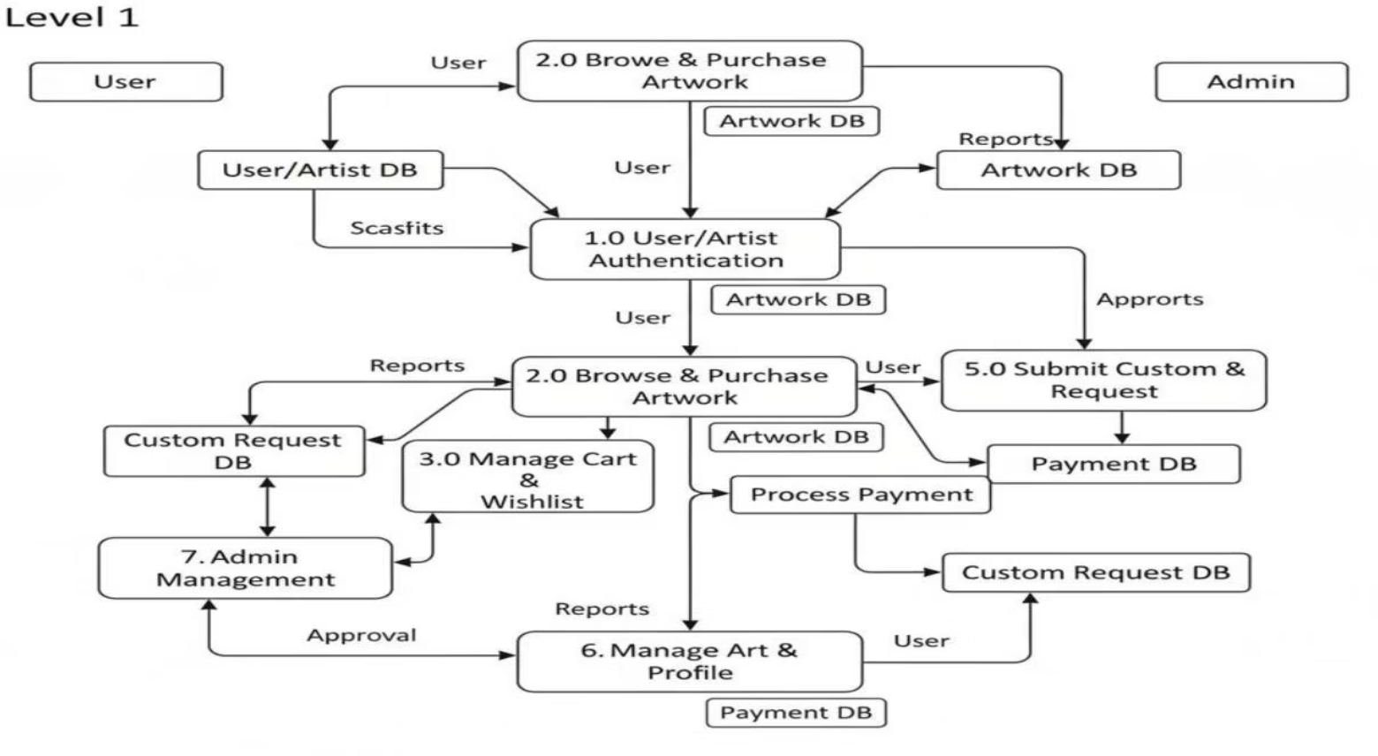
System Flow: Data Flow Diagrams
DFD Level 0: Context View
DFD Level 1: Detailed Processes
High-level overview of system interactions with external entities.
Breaks down the main processes, showing data flow within the system.

Slide 7
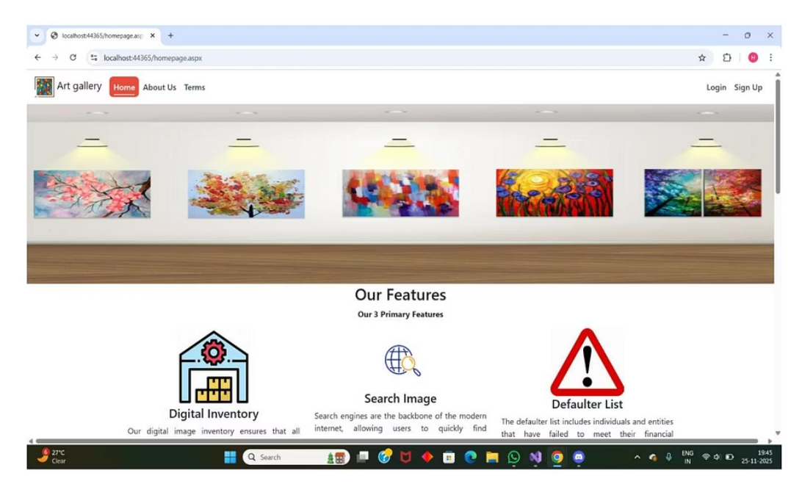
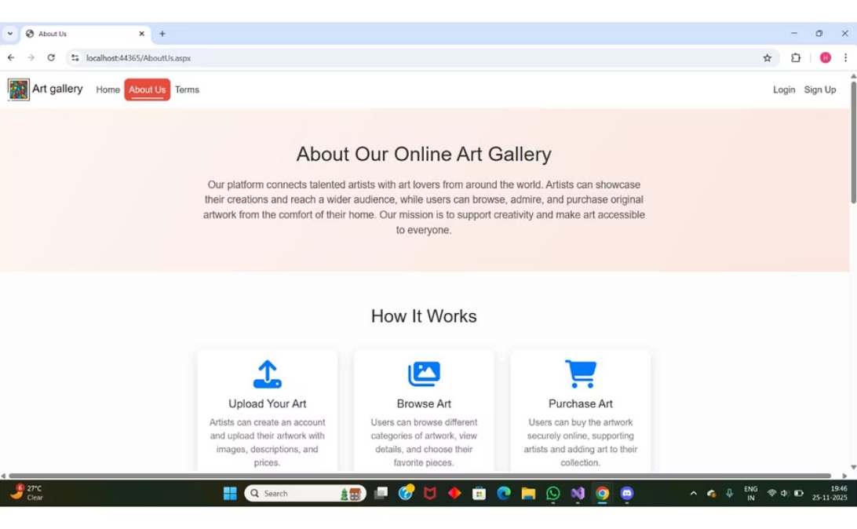
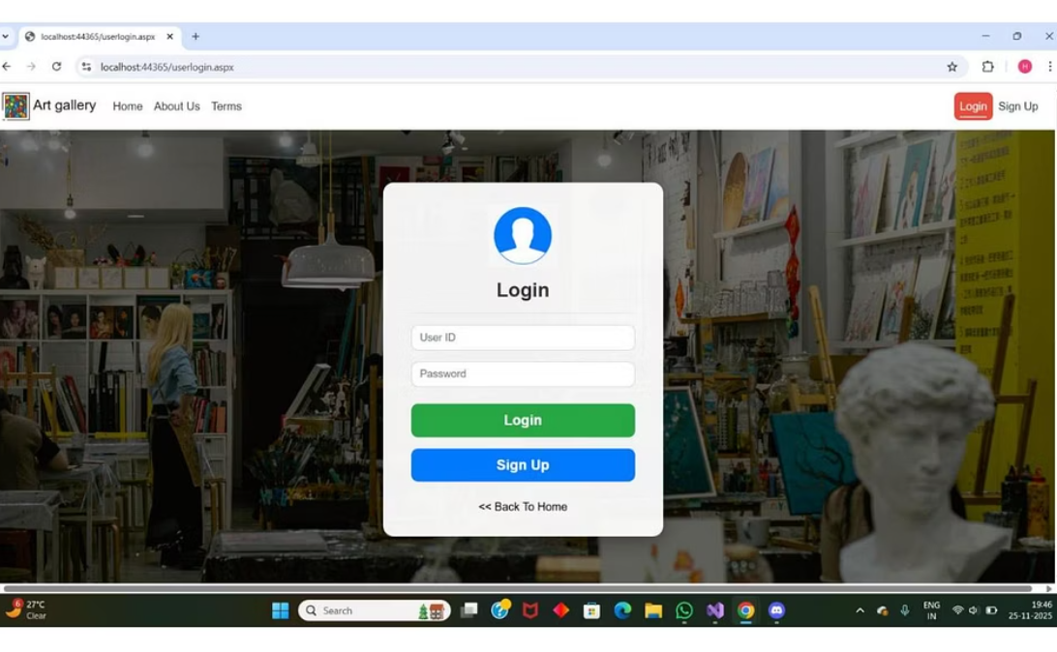
User Experience: Key Interfaces
Home Page
About Us
User Login
Vibrant digital art space with key features and sample paintings.
Explains mission, working process, and introduces the team.
Clean, modern design for secure user authentication.

Slide 8
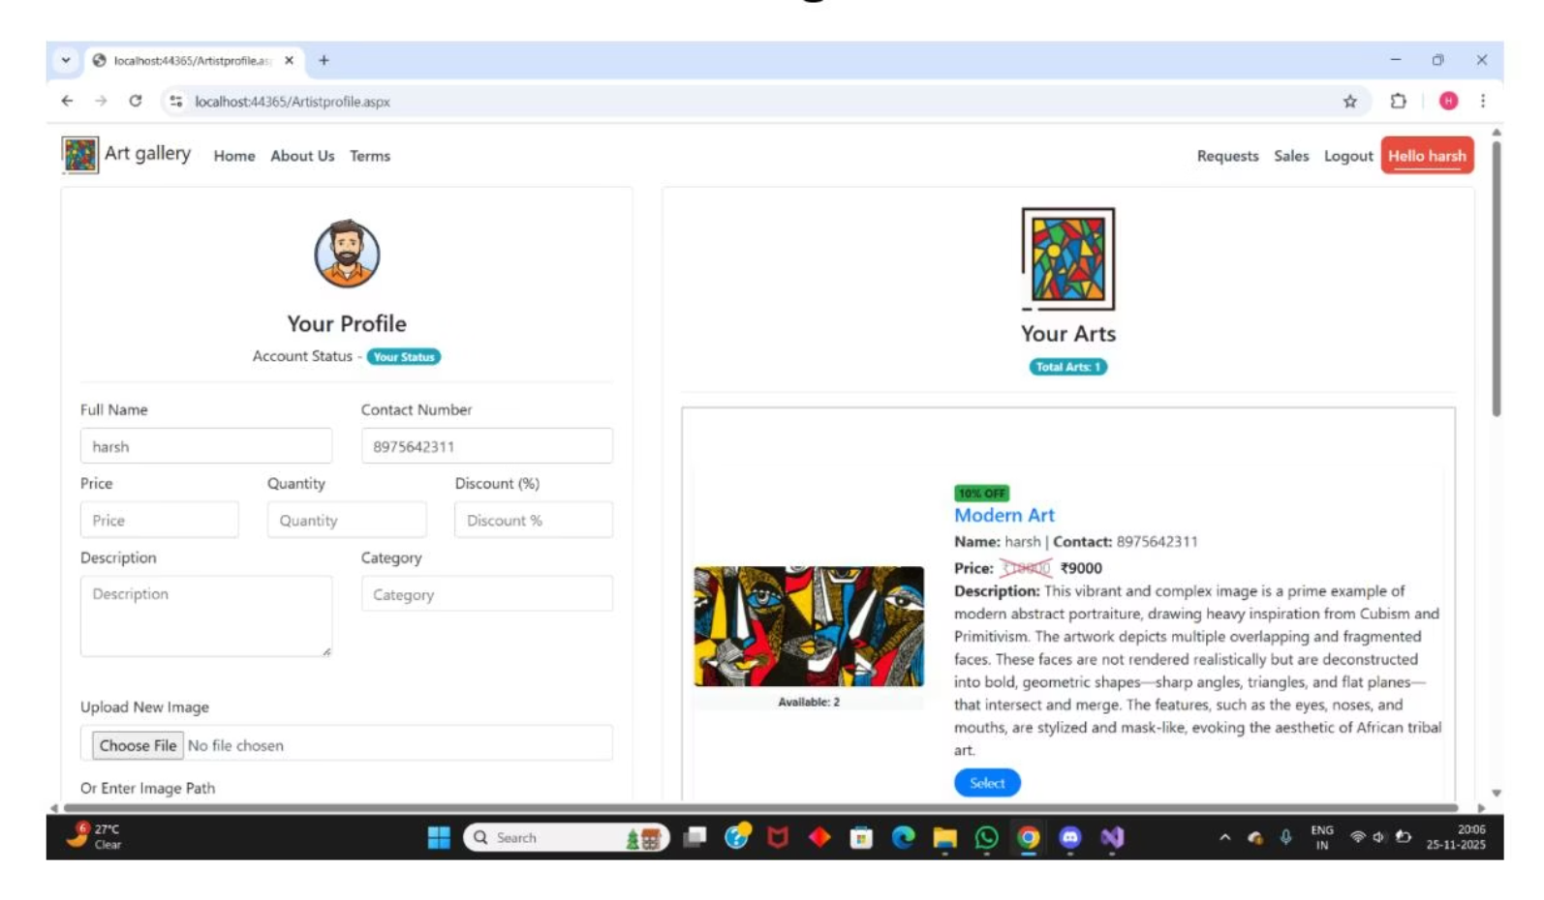
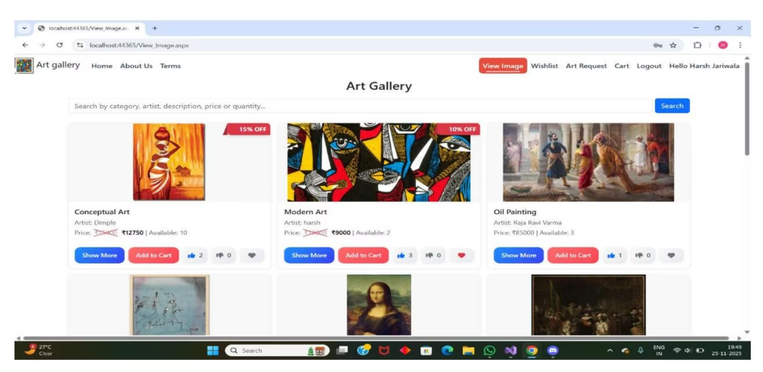
Seamless Shopping & Artist Management
Artwork Listing & Shopping
Artist Profile & Listing Panel
Browse, search, add to cart, and wishlist with ease.
Artists manage personal details, artwork, and inventory.

Slide 9
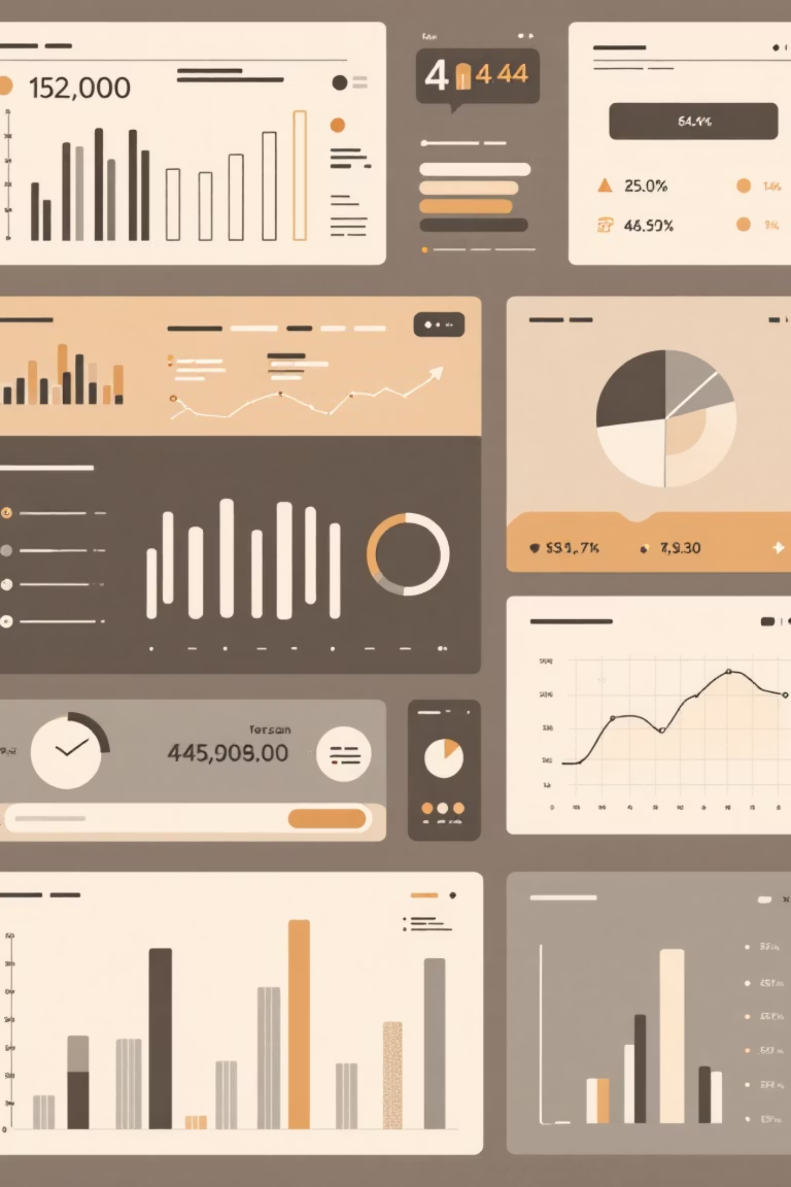



Admin Control & Analytics
Artist Management
Sales Analytics
Admins manage artist records, profiles, and status updates.
Detailed dashboards for artists and admins to track performance and revenue.
Order Overview
Efficient tracking of standard and custom artwork orders.

Slide 10

Conclusion & Future Vision
Complete Digital Platform
Stable & Secure
Future Enhancements
Connects artists and buyers securely and efficiently.
Built with ASP.NET Web Forms and SQL Server for reliability.
Payment gateways, auctions, mobile apps, advanced analytics.

